Slide 1


MARKETING
INSIGHTS

Slide 2

CONTENT
01
GOALS & OBJECTIVES
02
METHODOLOGY
03
TRAINING
04
INSIGHTS
05
CONCLUSIONS

Slide 3





GOALS & OBJECTIVES
To investigate the dataset, break it down and begin drilling into the various questions that you may have.
Develop a methodology to derive insights fast within a short span of time before the next marketing campaign starts.
Immediate utilization of insights to save on business costs, re-direct efforts and further maximize sales success rates.
INVESTIGATION
TIME
IMPACT

Slide 4

METHODOLOGY
With limited time, a fast and impactful way to derive insights needs to be done quantitatively.
With that model, coalition game theory was used in order to determine the most important attributes that impacted term deposits.
The raw dataset that was given to us went through the usual process of delimiting, removal of empty rows and also preparation for model training.
A machine learning model (XGBoost) was trained on the dataset that was optimized for 100 times to produce as accurate a model as possible within the given time.
INSIGHTS
DATA CLEANING
MODEL TRAINING

Slide 5

INSIGHTS

Slide 6
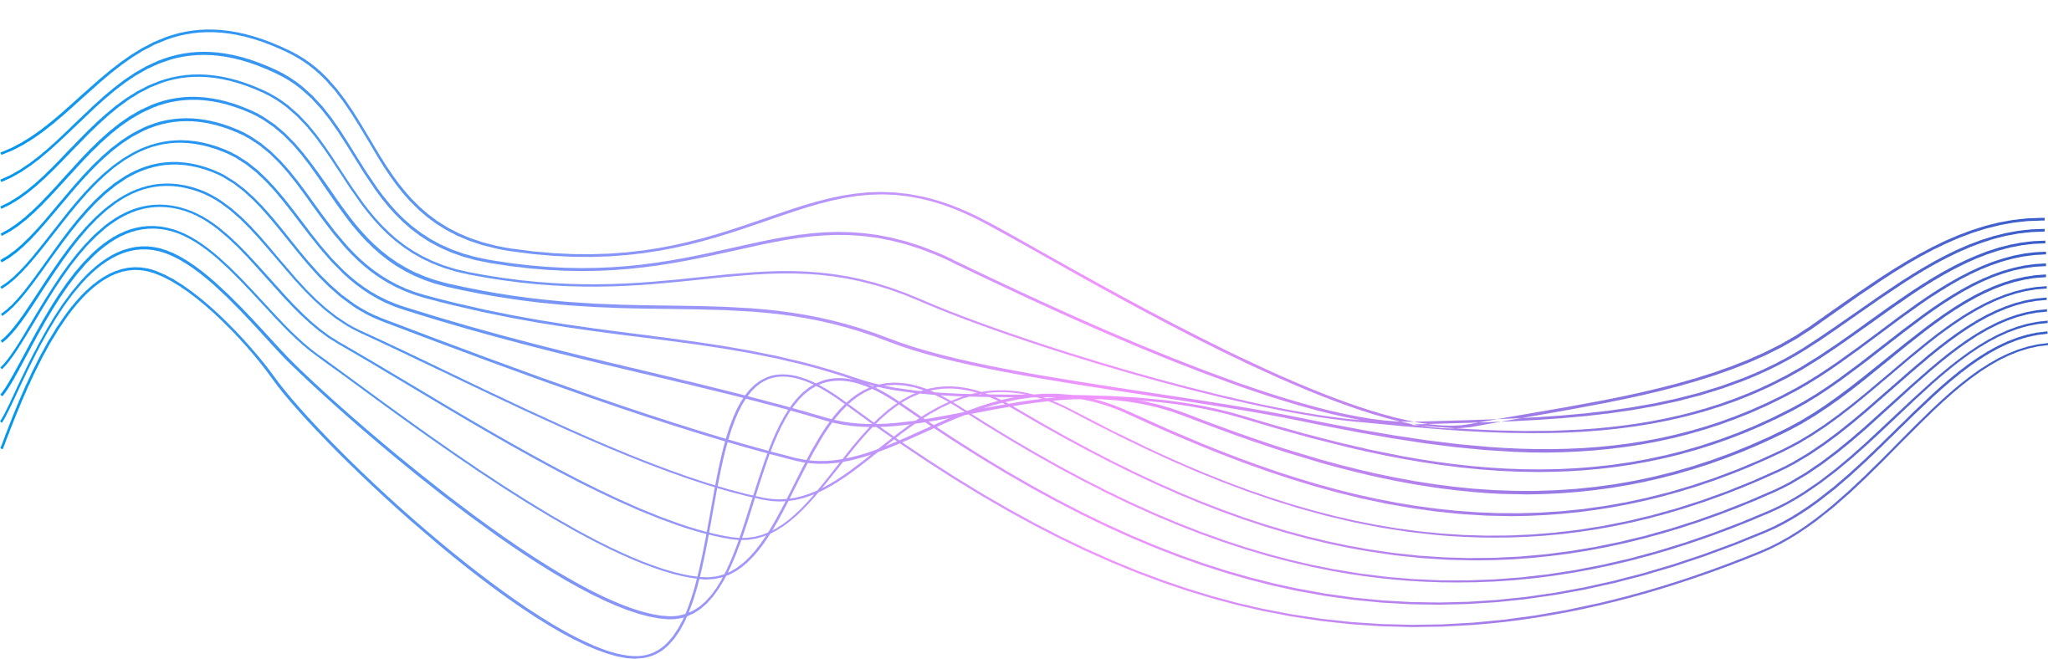

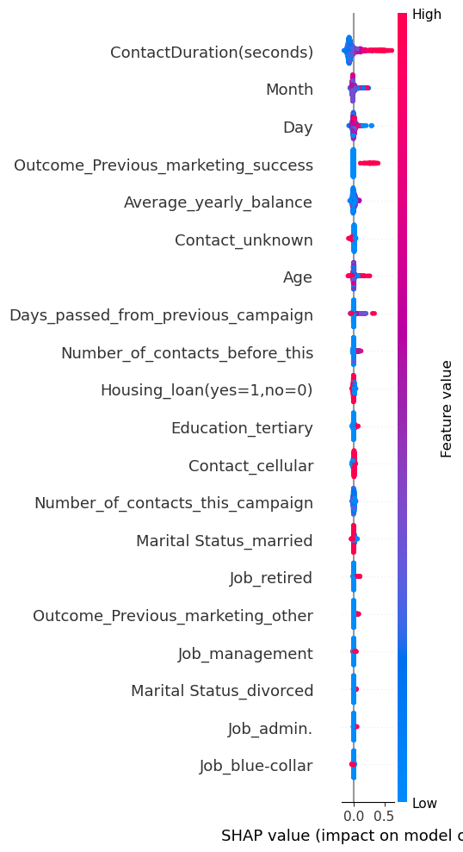
INSIGHTS AT A GLANCE
The plot on the right gives a quick overview into the overall insights.
The Red values denote the higher end of the range for that specific feature with the Blue denoting the lower end of the range.
Using the resultant model the following features were highlighted in importance to investigate:
Contact Duration of the Phone Call
The Month
Outcome of Previous Marketing Campaign
Age of the receipient
Job (Retired)
Marital Status
Job (Admin)
)

Slide 7
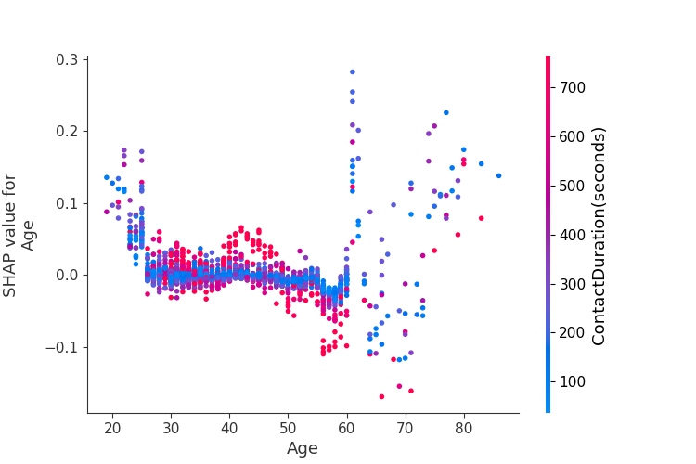


EXAMPLE OF DRILL DOWN.
Callers need to spend more than 500 seconds for ages 40-50
From the summary chart, we can then plot the dependency charts to show the impact of the various other features against Contact Duration.
With this we can gain insights into where to focus our marketing efforts in.
From this chart we can determine the following:
Calls to people below the age of 25 tend to yield less failures vs success compared to other age groups.
The age group of 40-50 requires the highest amount of convincing with contact duration being 600-700 seconds.
It is a waste of manhours to speak to people aged 50 and above for more than 400 seconds.
Values above 0 means better chances of success. Below means it is detrimental.
Calls to people who are 25 and below tend to have better chances of a successful “Yes” to bank deposits
Callers should not spend more than 500 seconds on a call with people age 50 and above

Slide 8
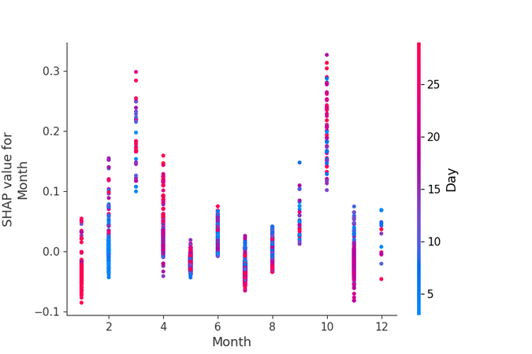
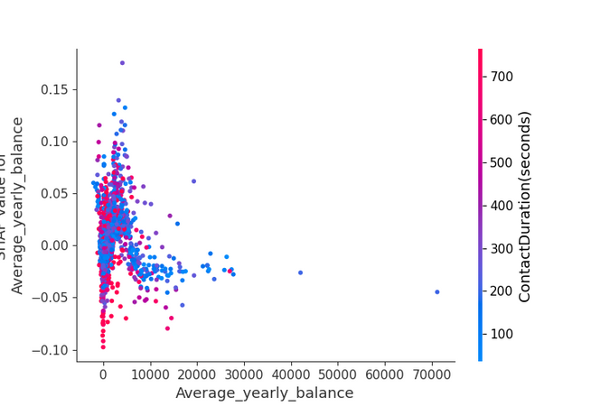

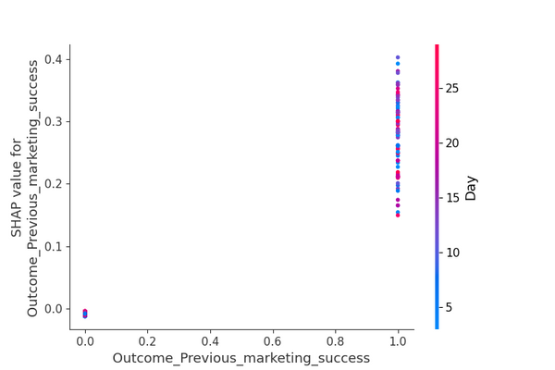
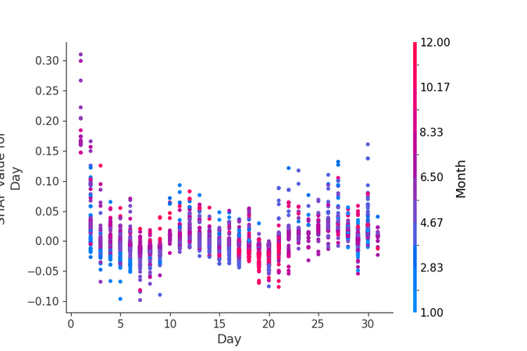
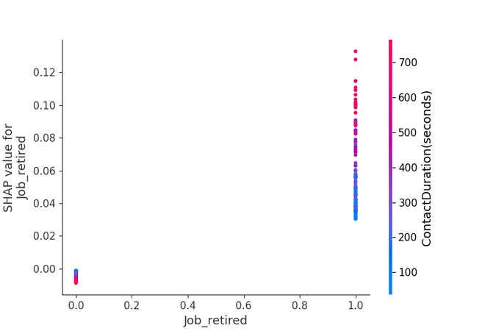
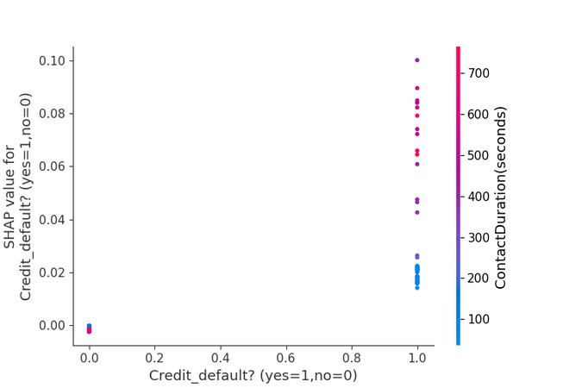
MAIN POINTERS FROM EACH PLOT
The best month of success is in March and in October.
The worse is in late Jan, May, July and November.
Best to target people with average yearly balance of less than $60,000
People whom marketing was successful before should be focused on.
Calling on the first of every month yields the highest chances.
Retirees are very likely the best people to interact with that has the most success.
People who defaulted on credit are likely to be interested than those who did not.

Slide 9
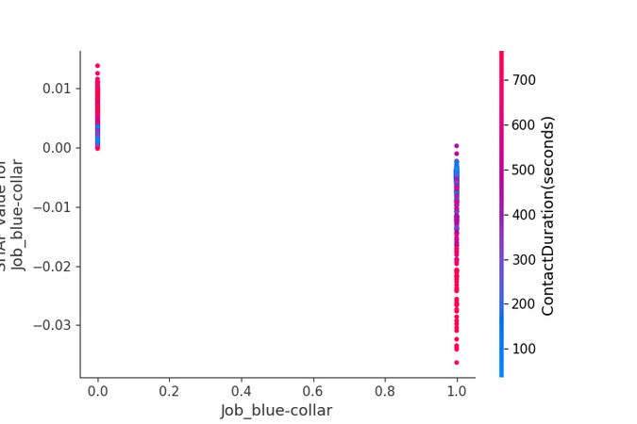
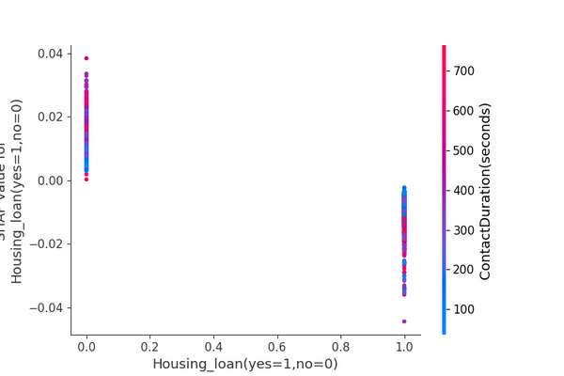
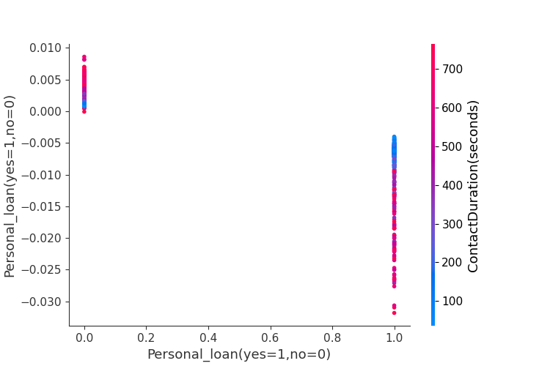
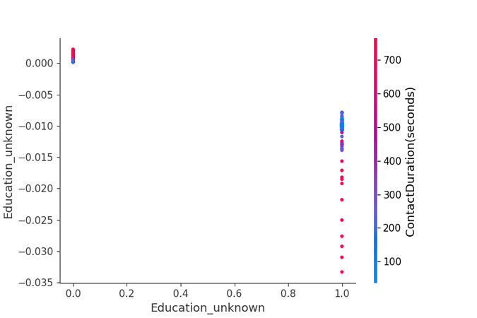
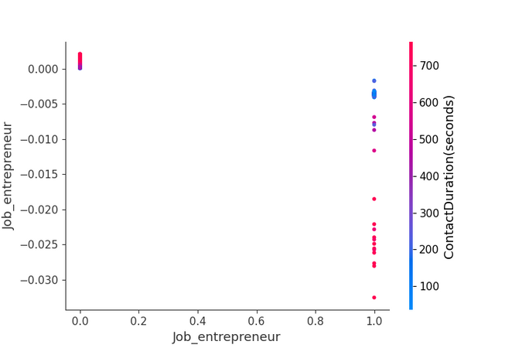
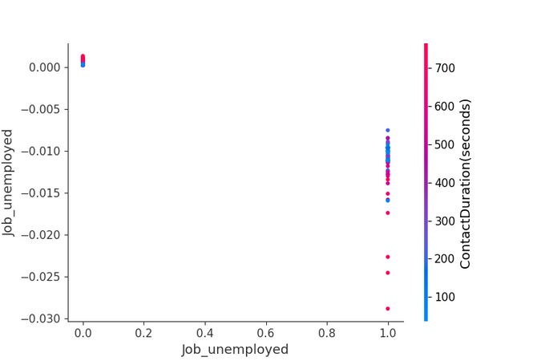
WHO TO AVOID
Avoid blue collar workers
Avoid those with housing loans.
Avoid people with personal loans.
Avoid people who’s education is unknown.
Avoid Entrepreneuers
Avoid unemployed people

Slide 10








WHO ARE WE LOOKING FOR?
We are looking to keep people talking on the phone. But we are also...
Looking for to maximize revenue...
Avoiding to save costs...
RETIREES
PEOPLE WHO WORK IN SERVICES
PEOPLE WHO WORK IN ADMIN
PEOPLE WHO ARE HOUSEMAIDS
PEOPLE WHOM PREVIOUS CAMPAIGNS WERE SUCCESSFUL
LESS THAN $60,000 IN AVERAGE BALANCE
WHOM DEFAULTED ON CREDIT
ENTREPRENEURS
UNEMPLOYED CUSTOMERS
PEOPLE WHO WORK IN BLUECOLLAR JOBS
PEOPLE WHO HAVE A HOUSING LOAN
PEOPLE WHO HAVE A PERSONAL LOAN
MORE THAN $60,000 IN AVERAGE BALANCE
PEOPLE WHOM PREVIOUS CAMPAIGNS WERE UNSUCCESSFUL

Slide 11


THANK YOU
P.S
Efforts should be focused on March & October for the best chances

